Slide 1
Chapter 3: Basic Cryptography
Dr. Sara Qaisar

Slide 2
Learning Objectives
01
Define cryptography
02
Describe hash, symmetric, and asymmetric cryptographic algorithms
03
Explain different cryptographic attacks
04
List the various ways in which cryptography is used

Slide 3

Cryptography
Cryptography (from Greek words meaning hidden writing) is the practice of transforming information so that it is secure and cannot be accessed by unauthorized parties.
This is accomplished through scrambling the information in such a way that only approved recipients can access it.
Whereas cryptography scrambles a message so that it cannot be understood, steganography hides the existence of the data.
What appears to be a harmless image can contain hidden data, usually some type of message, embedded within the image.
Steganography typically takes the data, divides it into smaller pieces, and hides these in unused portions of the file.
Steganography may hide data the file header fields that describe the file, between sections of the metadata (data that is used to describe the content or structure of the actual data), or in the areas of a file that contain the content itself.
Steganography can use a wide variety of file types image files, audio files, video files, etc.to hide messages and data.

Slide 4
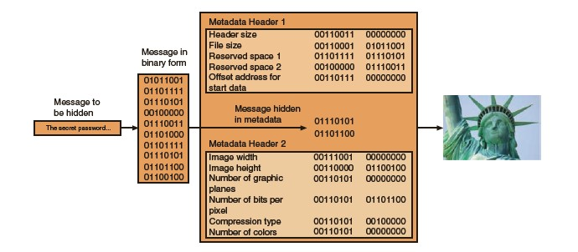

Slide 5
When using cryptography, the process of changing the original text into a scrambled message is known as encryption (the reverse process is decryption, or changing the message back to its original form).
In addition, there is other terminology that applies to cryptography:
Plaintext. Unencrypted data that is input for encryption or is the output of decryption is called plaintext.
Ciphertext. Ciphertext is the scrambled and unreadable output of encryption.
Cleartext. Cleartext is readable data that is stored or transmitted without encryption. Unlike plaintext, cleartext is never intended to be encrypted.

Slide 6
Plaintext data is input into a cryptographic algorithm (also called a cipher), which consists of procedures based on a mathematical formula to encrypt and decrypt the data.
A key is a mathematical value entered into the algorithm to produce the ciphertext.
Just as a key is inserted into a door lock to lock the door, in cryptography a unique mathematical key is input into the encryption algorithm to “lock down” the data by creating the ciphertext.
When the ciphertext is to be returned to plaintext, the reverse process occurs with a decryption algorithm and key.

Slide 7
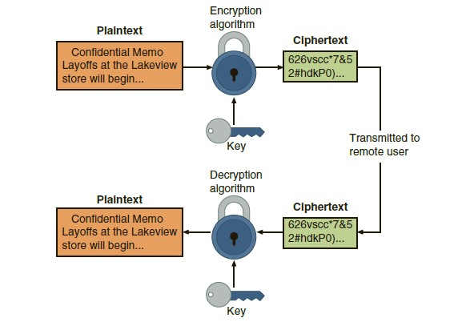

Slide 8
Ciphers

Slide 9
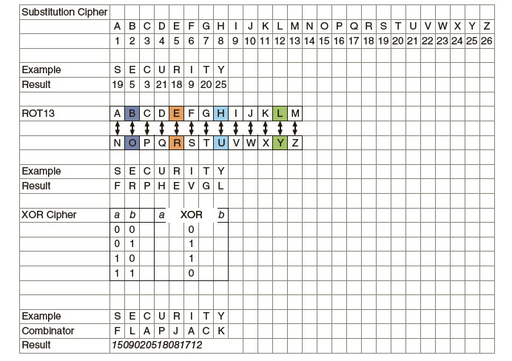

Slide 10
There are different categories of algorithms and within those different types.
One category is a substitution cipher that substitutes one character for another. By substituting 1 for the letter A, 2 for the letter B, etc., the word security becomes 1804022017081924 (-1 for 1953211892025).
One type of substitution cipher is a ROT13, in which the entire alphabet is rotated 13 steps: A=N, B=O, etc., so that the word security becomes frphevgl.
Another common algorithm is the XOR cipher. This is based on the binary operation eXclusive OR that compares two bits: if the bits are different a 1 is returned, but if they are identical then a 0 is returned. For example, to encrypt the word security by “XOR-ing” it with the word flapjack the binary equivalent of the first letter s(01110011) is compared with that of the letter f (01100110) to return 00010101. Then the letter e is compared with the l, etc., followed by a comparison of each remaining letter.

Slide 11
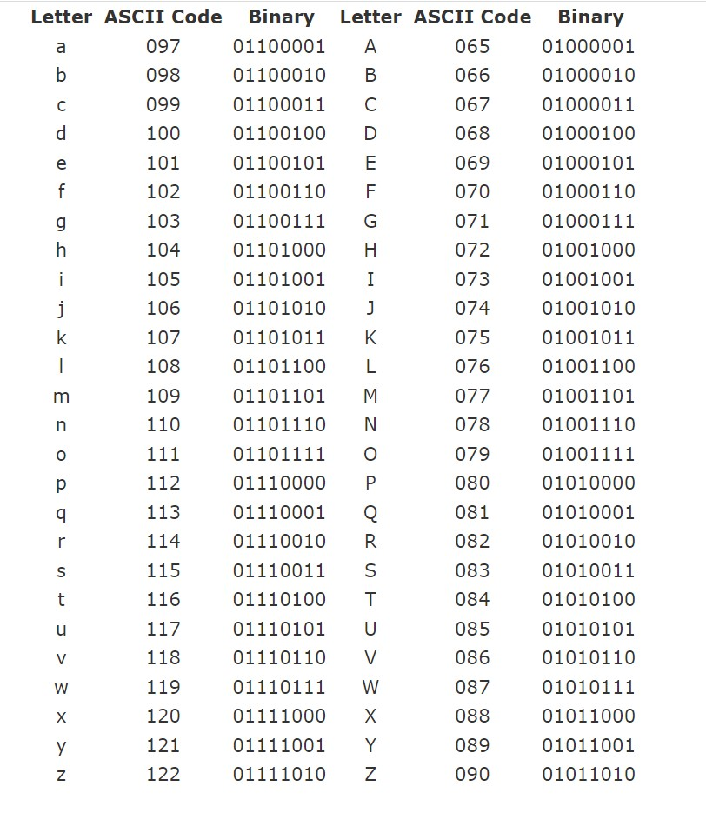
Alphabet to Binary

Slide 12
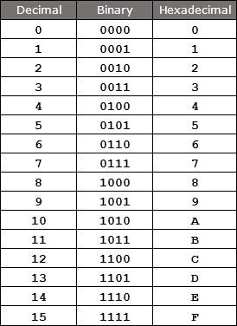
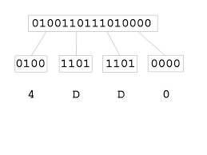
Binary to HexaDecimal

Slide 13
ROT-13
The ROT-13 cipher was commonly used to hide the meaning of messages on the Internet (particularly on Usenet and E-mail).
Each letter in the plaintext is substituted with the ciphertext letter according to the following mapping:
p : A B C D E F G H I J K L M N O P Q R S T U V W X Y Z
F(p) : N O P Q R S T U V W X Y Z A B C D E F G H I J K L M
Example:
Plaintext: THIS IS A SECRET
Ciphertext: GUVF VF N FRPERG
The ROT-13 cipher is an involution (i.e., self-inverse) so that encoding twice will result in the original message.

Slide 14
Caesar Cipher
The Roman emperor Julius Caesar used to substitute each letter in his diplomatic communications with the letter that was three letters further along in the alphabet.
p : A B C D E F G H I J K L M N O P Q R S T U V W X Y Z
F(p) :D E F G H I J K L M N O P Q R S T U V W X Y Z A B C
Plaintext: ET TU BRUTUS
Ciphertext: HW WX EUXWXV

Slide 15


Affine Cipher
The Affine cipher is a type of mono-alphabetic substitution cipher, wherein each letter in an alphabet is mapped to its numeric equivalent, encrypted using a simple mathematical function, and converted back to a letter
Encryption Function
Decryption Function
Here a and m must be coprime numbers

Slide 16
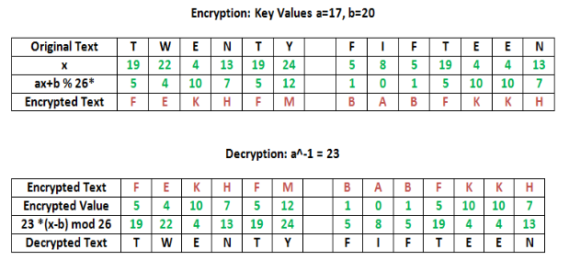
Affine Cipher Example

Slide 17
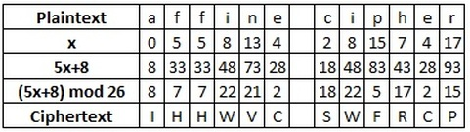
Affine Cipher Example

Slide 18
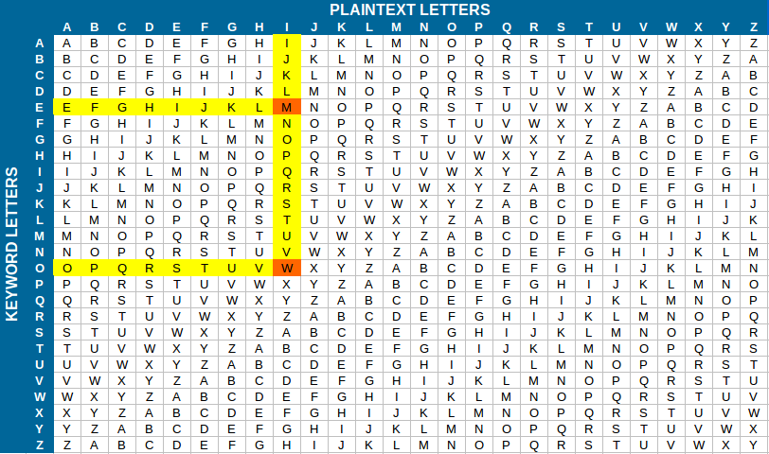
Vigenère Cipher

Slide 19
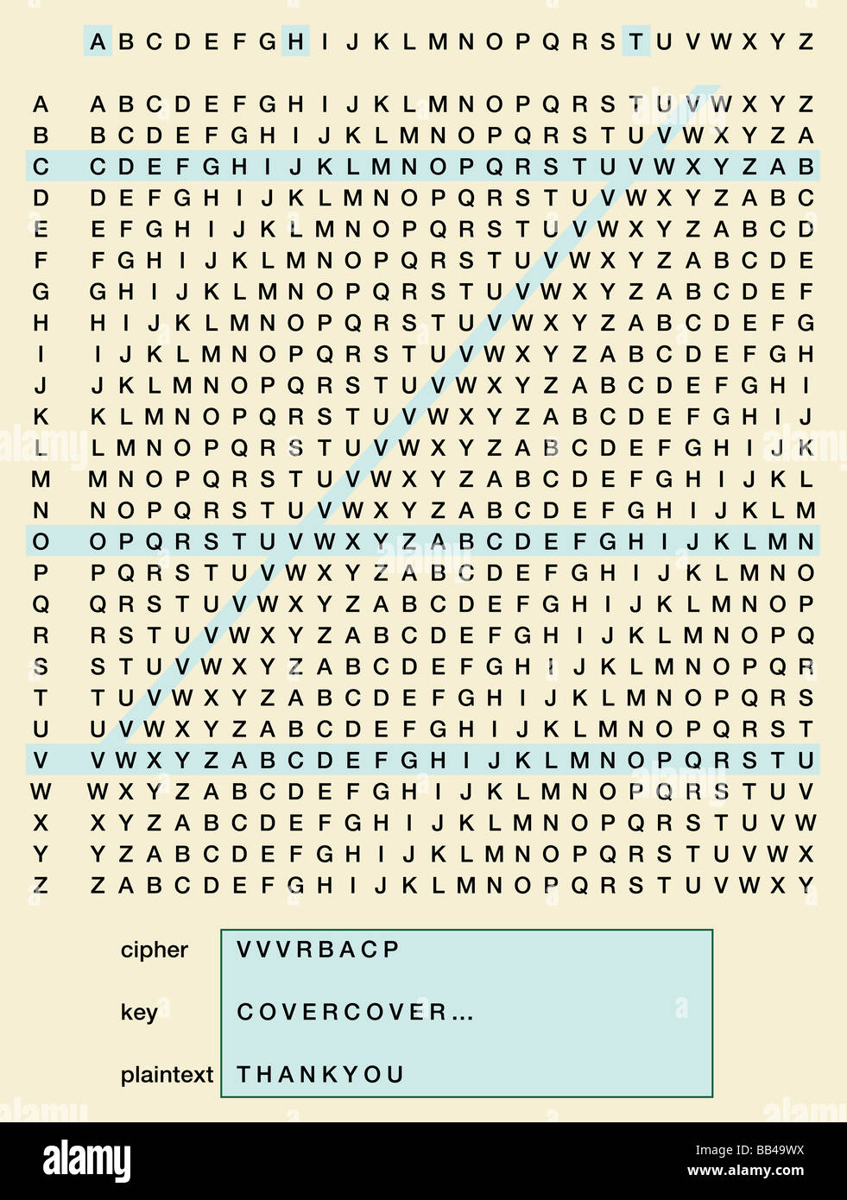

Slide 20

Transpositional Cipher: Railfence
The plaintext is written down as a sequence of diagonals and then read off as a sequence of rows.
For example, to encipher the message “meet me after the toga party” with a rail fence of depth 2, we write the following:
The encrypted message is
MEMATRHTGPRYETEFETEOAAT

Slide 21
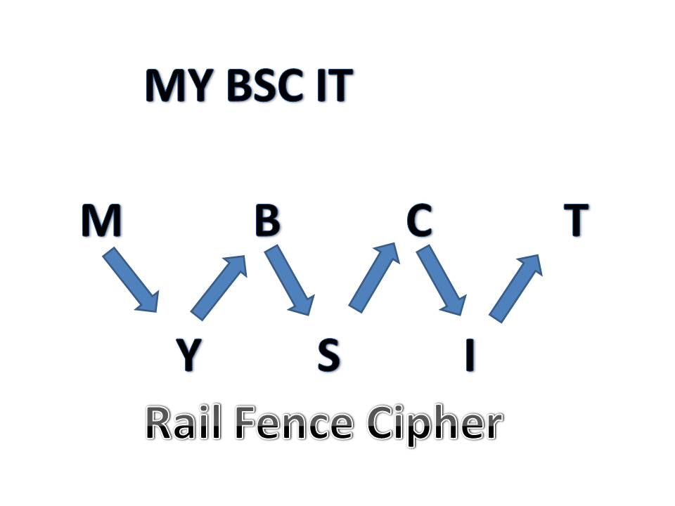
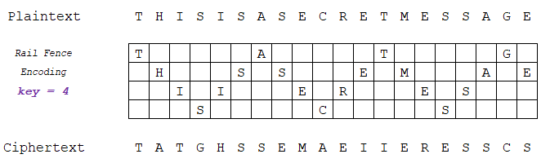

Slide 22
Columnar Transpositional Cipher
Problems with the rail fence cipher:
The first and last letters of the plaintext do not move
The key is a number that divides the total message length
In a single columnar transposition cipher, the key is a word or phrase whose letters, in alphabetic order, indicate the order of the columns as they are read
Example:
Plaintext: TRANSPOSITIONCIPHER
Key is “SECRET”, so re-write as rows of 6-letter blocks:
SECRET CEERST
521436 123456
TRANSP ARSNTP
OSITIO ISITOO
NCIPHE ICHPNE
RXXXXX XXXXRX
–Ciphertext: AIIXRSCXSIHXNTPXTONRPOEX

Slide 23
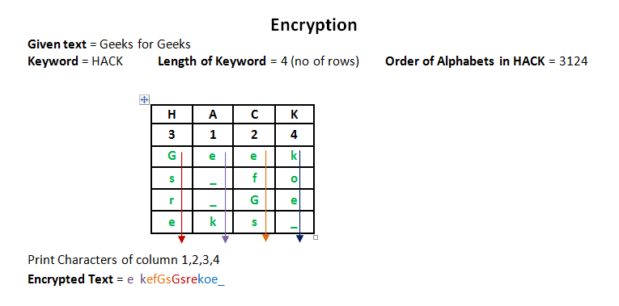

Slide 24
Threat actors often use sophisticated statistical analysis on the ciphertext (cryptoanalysis) to try to discover the underlying key to the cryptographic algorithm.
There are two factors that can thwart statistical analysis to make a strong algorithm. One factor is diffusion.
Diffusion means that if a single character of plaintext is changed then it should result in multiple characters of the ciphertext changing.
Eliminating a one-to one correspondence between the plaintext and the ciphertext makes it more difficult for a threat actor to perform cryptoanalysis, since the plaintext is diffused across several characters of the ciphertext.
Another factor is confusion, which means that the key does not relate in a simple way to the ciphertext.
Each character of the ciphertext should depend upon several different parts of the key.
This forces the threat actor to create the entire key simultaneously, a difficult task, rather than trying to recreate the key piece by piece.

Slide 25
Cryptography and Security

Slide 26
Confidentiality. Cryptography can protect the confidentiality of information by ensuring that only authorized parties can view it. When private information, such as a list of employees to be laid off, is transmitted across the network or stored on a file server, its contents can be encrypted, which allows only authorized individuals who have the key to see it.
Integrity. Cryptography can protect the integrity of information. Integrity ensures that the information is correct and no unauthorized person or malicious software has altered that data. Because ciphertext requires that a key must be used to open the data before it can be changed, cryptography can ensure its integrity. The list of employees to be laid off, for example, can be protected so that no names can be added or deleted by unauthorized personnel.
Authentication. The authentication of the sender can be verified through cryptography. Specific types of cryptography, for example, can prevent a situation such as circulation of a list of employees to be laid off that appears to come from a manager, but in reality, was sent by an imposter.

Slide 27
Non-repudiation. Cryptography can enforce non-repudiation. Repudiation is defined as denial; non-repudiation is the inability to deny. In information technology, non-repudiation is the process of proving that a user performed an action, such as sending an email message. Non-repudiation prevents an individual from fraudulently reneging on an action. The non-repudiation features of cryptography can prevent a manager from claiming he never sent the list of employees to be laid off to an unauthorized third party.
Obfuscation. Obfuscation is making something obscure or unclear. One example may be disguising the operational details of software so that a threat actor cannot “reverse engineer” the program to determine how it is functioning to bypass its security protections. Cryptography can help ensure obfuscation by hiding the details so that the original code cannot be determined in order that an unauthorized user cannot see the list of employees to be laid off.

Slide 28
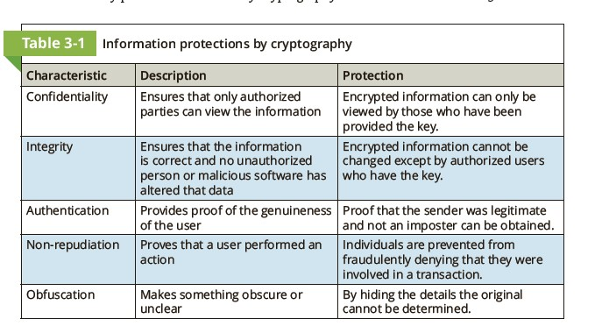
Cryptography can provide a range of security protections. Cryptography can support the following basic protections:

Slide 29
Cryptography can provide protection to data as that data resides in any of three states:
Data in-use. Data-in-use is data actions being performed by “endpoint devices,” such as printing a report from a desktop computer.
Data in-transit. Actions that transmit the data across a network, like an email sent across the Internet, are called data-in-transit.
Data at-rest. Data-at-rest is data that is stored on electronic media.
Because cryptography can provide protection to data in these three states and not in just one single state this make cryptography a key defense against threat actors.

Slide 30
Cryptographic Algorithms

Slide 31
Cryptanalysis

Slide 32
Cryptanalysis
Cryptanalysis is the study of breaking ciphers (also called code breaking or cracking) or reading encrypted messages without knowledge of the key
Goals:
Decrypt a message
Recover the key
Types of attacks depend on:
The type of information available
Interaction with the cipher

Slide 33
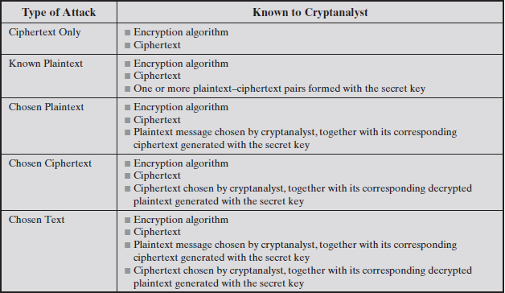
Types of Attacks on Encrypted Messages

Slide 34
Computational vs. Unconditional Secure
An encryption scheme is unconditionally secure if the ciphertext generated by the scheme does not contain enough information to determine uniquely the corresponding plaintext, no matter how much ciphertext is available.
That is, no matter how much time an opponent has, it is impossible for him or her to decrypt the ciphertext simply because the required information is not there
An encryption scheme is said to be computationally secure if either of the foregoing two criteria are met.
Unfortunately, it is very difficult to estimate the amount of effort required to cryptanalyze ciphertext successfully.

Slide 35
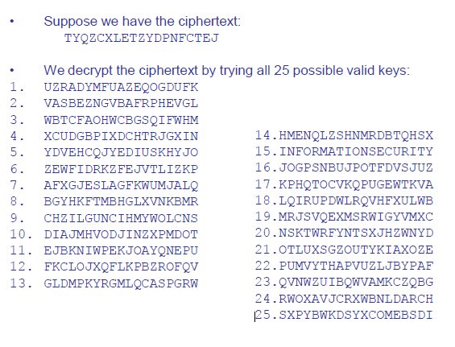
Example: Exhaustive key search

Slide 36
Brute Force Search
Always possible to simply try every key
Most basic attack, proportional to key size

Slide 37
Cracking the simple substitution cipher
There are 26! = ~4 x 10^26 possible keys
Exhaustive key search is not practical
Simple substitution ciphers were considered strong for many centuries
In 850 CE, Arab/Iraqi scientist Abu Yusuf Yaqub ibn Ishaq al-Kindi published his book “Risalah fi Istikhraj al-Mu‟amma” (A Manuscript on Deciphering Cryptographic Messages), which contains the first ever published description of how to crack simple substitution ciphers
The method he described is now known as frequency analysis

Slide 38
Frequency analysis
The statistical distribution of letter frequencies of a message (text) written in any language tend towards a known letter frequency distribution profile of the language
This is particularly true for long messages (i.e., the longer the text, the closer the letter frequency distributions match the language's letter frequency distributions)
The simple substitution cipher preserves the letter frequency distributions of the plaintext in the ciphertext (i.e., information about the plaintext is leaked in the ciphertext)
The attacker takes a frequency count of the ciphertext letters and tries to match them to the letter frequency distribution profile of the plaintext language

Slide 39
One Time Pad
There are many variations of cryptographic algorithms. One variation is based on the device—if any—that is used in the cryptographic process.
Prior to this, cryptographic algorithms were entirely hand-calculated.
An example is a one-time pad (OTP) that combines plaintext with a random key.
A pad is a long sequence of random letters.
These letters are combined with the plaintext message to produce the ciphertext.
To decipher the message, the recipient must have a copy of the pad to reverse the process.

Slide 40
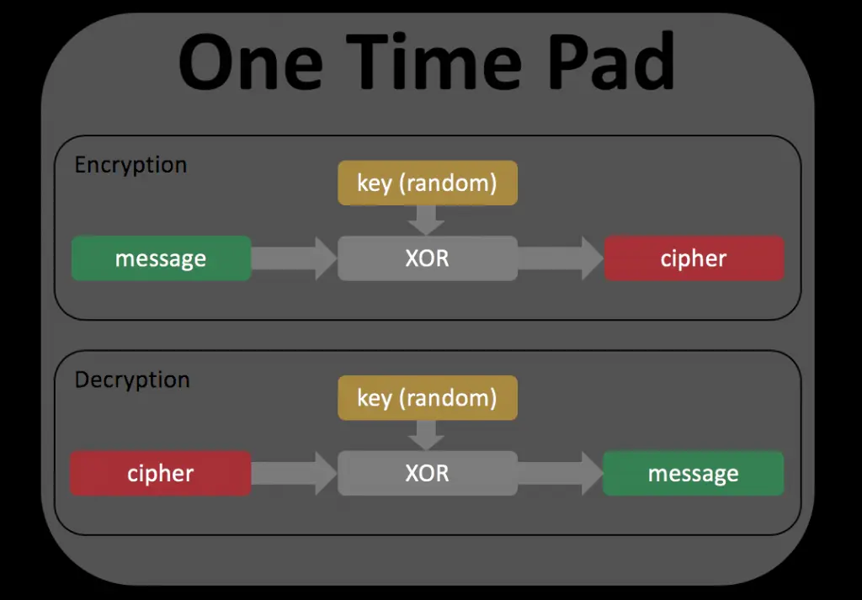
One Time Pad

Slide 41
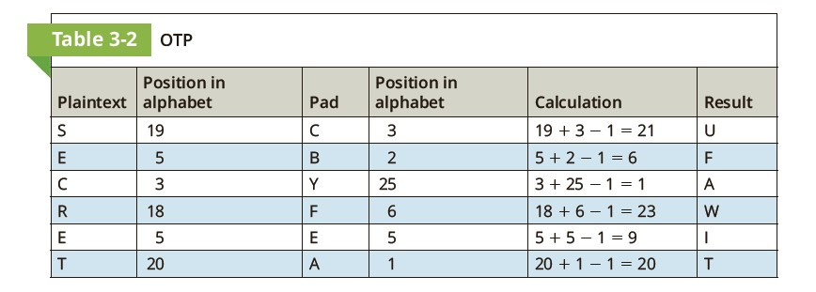
To encipher a message, the position in the alphabet of the first letter in the plaintext message is added to the position in the alphabet of the first random letter from the pad.
For example, if SECRET is to be encrypted using the pad CBYFEA, the first letter S (#19 of the alphabet) is added to the first letter of the pad C (#3 of the alphabet) and then 1 is subtracted (19 1 3 2 1 5 21). This results in U (#21 of the alphabet).
Each letter is similarly encrypted (any number larger than 26 is wrapped around to the start of the alphabet). To decipher a message, the recipient takes the first letter of the ciphertext and subtracts the first random letter from the pad (any negative numbers are wrapped around to the end of the alphabet).

Slide 42
Activity
Plain Text : ATTACK AT DAWN
Pad: YUPRQI TW JKBN

Slide 43
Thanks

